Slide 1

房价预测项目展示
黄皆瑞 2023200761
Team Name: Hola_Buenos_dias_0761

Slide 2
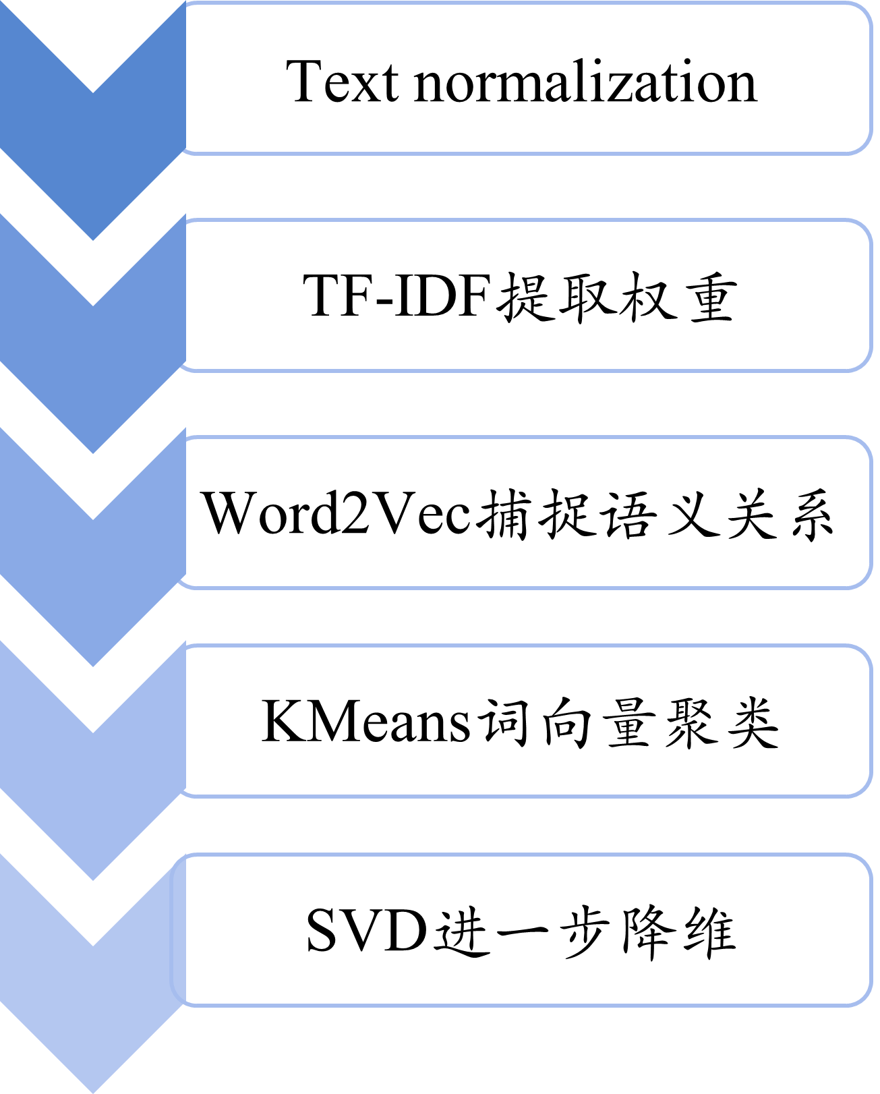

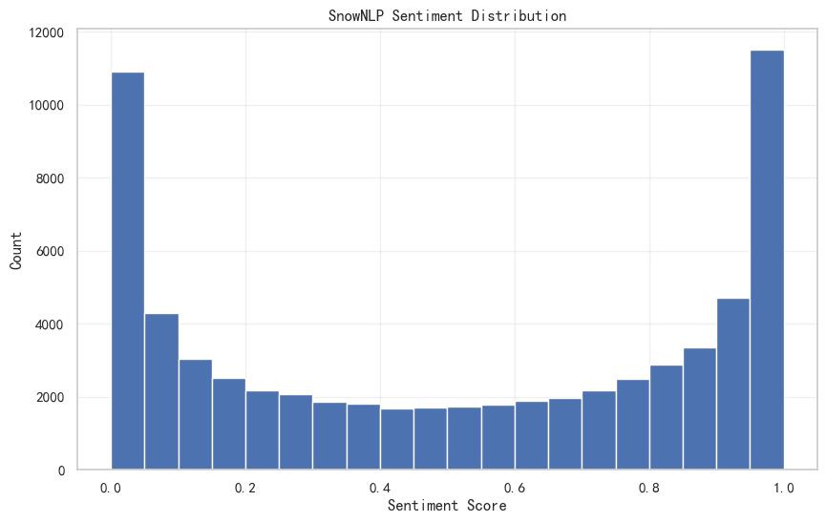
1.Natural Language Processing
1.1 Keyword →周边配套、交通出行、配套设施
1.2 核心文本处理 → 户型介绍、核心卖点
亮点：结合了TF-IDF的统计重要性和Word2Vec的语义相似性
SVD效果：50维度压至20，后续模型RMSE下降1.97%！
1.3 SnowNLP 情感评分→ 客户评价，获取情感特征
样本 | 采光好 | 南北通透 | 精装修 | …
s1 | 0.3 | 0.2 | 0.1 | …
s2 | 0 | 0.1 | 0.3 | …
s3 | 0.2 | 0.4 | 0.1 | …
s4 | 0.1 | 0 | 0.2 | …
词 | 向量维度1 | 向量维度2 | … | 向量维度d
采光好 | 0.12 | -0.08 | … | 0.33
南北通透 | 0.09 | -0.1 | … | 0.29
精装修 | 0.21 | 0.03 | … | -0.12
词 | cluster_id
采光好 | 0
南北通透 | 0
精装修 | 1
样本 | Cluster 0 | Cluster 1 | Cluster 2 | … | Cluster K-1
s1 | 0.5 | 0.1 | 0 | … | 0
s2 | 0.1 | 0.5 | 0.2 | … | 0
s3 | 0.1 | 0.5 | 0.1 | … | 0

Slide 3
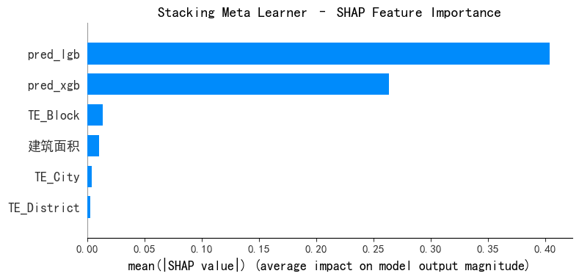
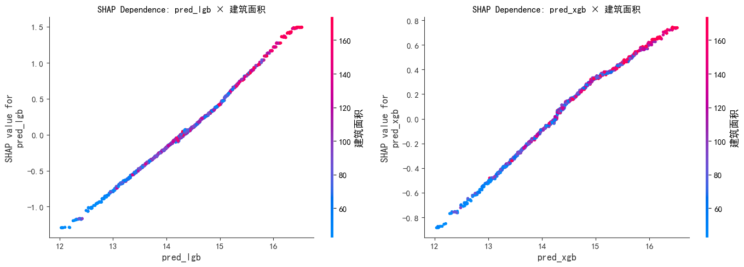
2.Stacking
2.1 Stacking（basic model：XGBoost & LightGBM）
Stacking model | Meta input
Basic Stacking | 仅基模型 OOF 预测
Ridge Meta | 基模型预测 + 地理 + 面积
LightGBM Meta | 基模型预测 + 地理 + 面积
2.2 亮点
结合 XGBoost 的稳健性与 LightGBM 的高分辨率拟合能力
严格 OOF 机制防止信息泄露
引入关键结构特征，学习条件化模型信任权重
采用浅层、强正则的 LGB Meta，提升性能&防止过拟合
Performance
Price：LGB-meta 最优（vs best base model RMSE -3.83%）
Rent：Basic Stacking 最优（ vs best base model RMSE -1.43%）
Price | In-sample RMSE | Out-of-sample | CV | vs LGB
XGB + LGB | 448,186 | 422,171 | 448,712 | -3.31%
+ Ridge-meta | 447,314 | 419,290 | 447,856 | -3.49%
+ LGB-meta | 431,123 | 417,061 | 446,278 | -3.83%
Rent | In-sample RMSE | Out-of-sample | CV | vs XGB
XGB + LGB | 136,399 | 137,914 | 136,486 | -1.43%
+ Ridge-meta | 136,761 | 138,343 | 136,768 | -1.22%
+ LGB-meta | 134,693 | 137,745 | 137,321 | -0.82%

Slide 4
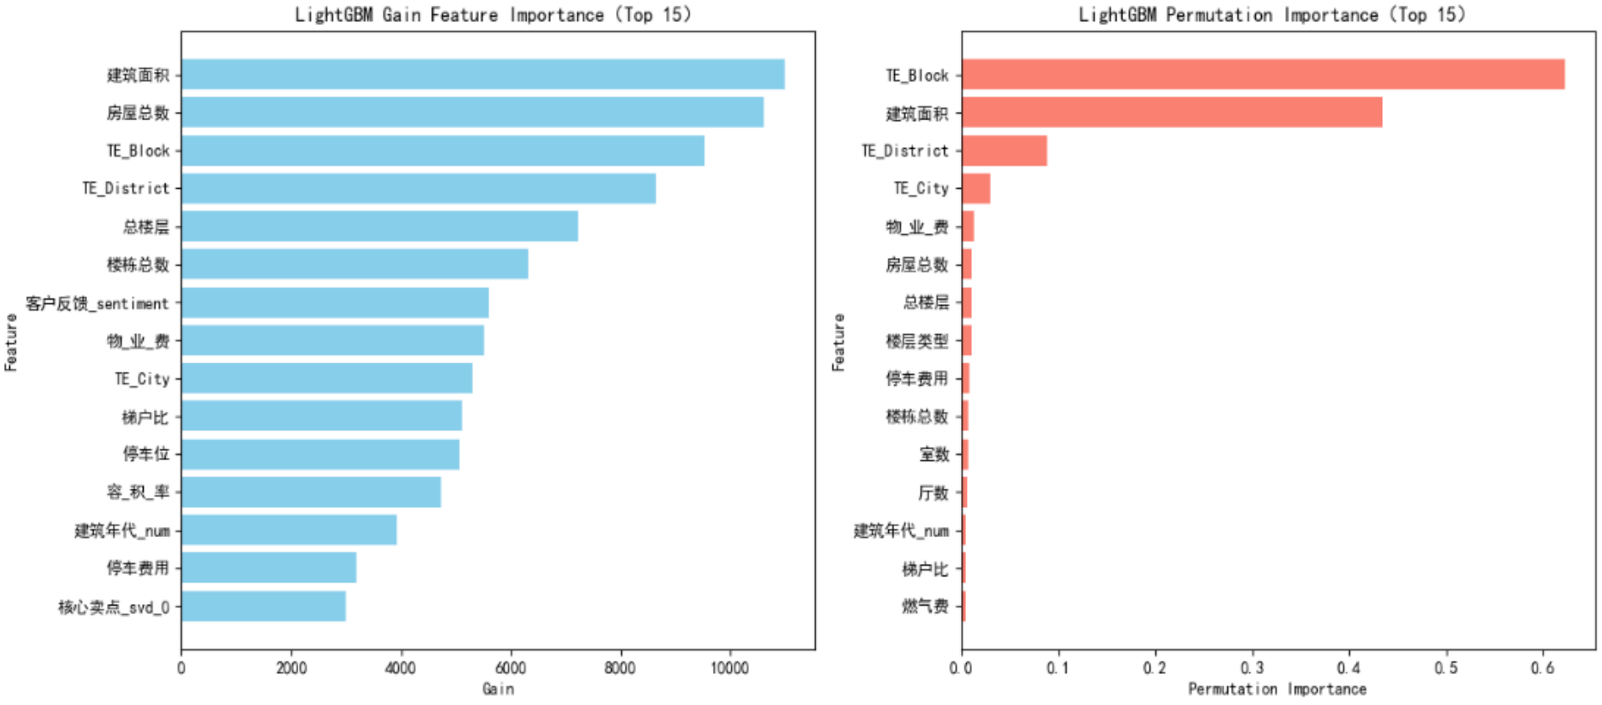
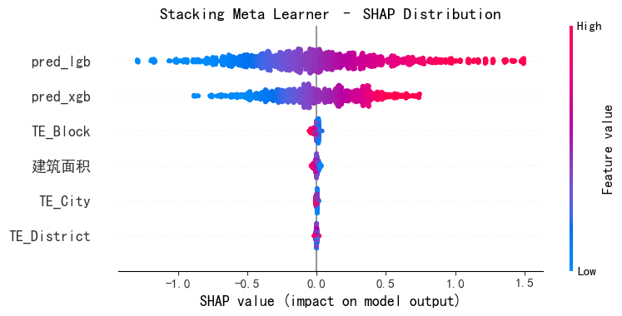
3. Model Evaluation
Progress
使用Optuna自动超参调优
可视化展示、地理特征处理
可解释性：SHAP 与偏依赖图对模型进行解释分析，量化特征对预测结果的边际影响
Price | In-sample | Out-of-sample | CV | Kaggle Score
Best Linear Model | 952386.31 | 939730.51 | 952513.38 | 43.90
XGBoost | 99606.84 | 428388.39 | 484158.60 | 74.40
LightGBM | 442904.56 | 431527.08 | 464072.21 | 74.20
Stacked (basic) | 448186.12 | 422170.98 | 448712.43 | 73.80
Stacked + Ridge-meta | 447313.54 | 419289.85 | 447856.08 | 74.30
Stacked + LGB-meta | 431123.27 | 417061.46 | 446277.82 | 74.70
Best Model | 431123.27 | 417061.46 | 446277.82 | 74.70
Figure 1 LightGBM Gain Feature & Permutation Importance
Rent | In-sample | Out-of-sample | CV | Kaggle Score
Best Linear Model | 243015.32 | 244483.74 | 243032.98 | 43.90
XGBoost | 69989.30 | 137587.62 | 138459.45 | 74.40
LightGBM | 87113.83 | 138172.64 | 139088.13 | 74.20
Stacked (basic) | 136398.75 | 137913.79 | 136485.64 | 73.80
Stacked + Ridge-meta | 136761.08 | 138342.61 | 136767.92 | 74.30
Stacked + LGB-meta | 134693.36 | 137744.87 | 137320.63 | 74.70
Best Model | 134693.36 | 137744.87 | 137320.63 | 74.70
Figure 2 Stacking Meta SHAP Distribution

